Slide 1

Spring of Code Artificial Intelligence (Machine Learning & Deep Learning)
Instructor Asad Ullah - Research Assistant (DIP Lab)
Duration 03 Months (Feb – April)

Slide 2

Day 05 – Python Fundamentals (Conditionals and Loops)
Objectives:
What are Conditional Statements?
What are Loops?
Python Indentation
What are Iterables?

Slide 3
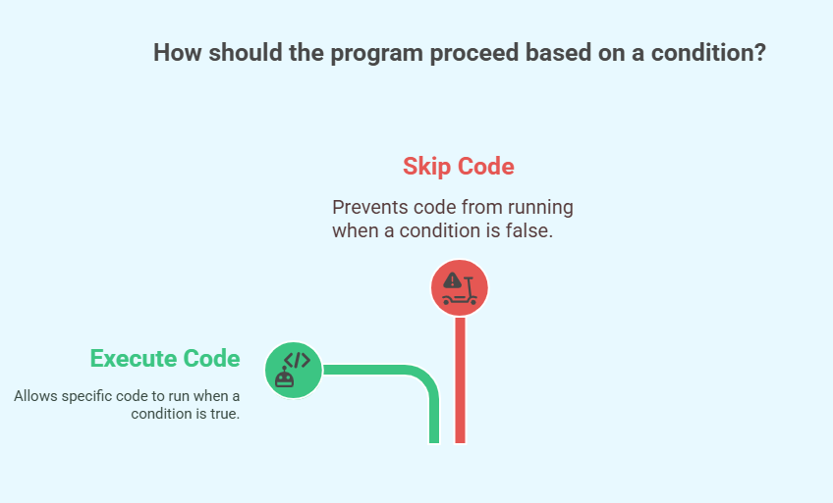
Conditional Statements
What Are Conditional Statements?
Conditional statements allow a program to make decisions based on whether a condition is True or False.
Why Use Conditions?
Control the flow of execution.
Executes code only when specific conditions are met.
Skip or branch logic based on outcomes.
Real-Life Example: Traffic light
If the light is green → cars go.
If the light is red → cars stop.

Slide 4
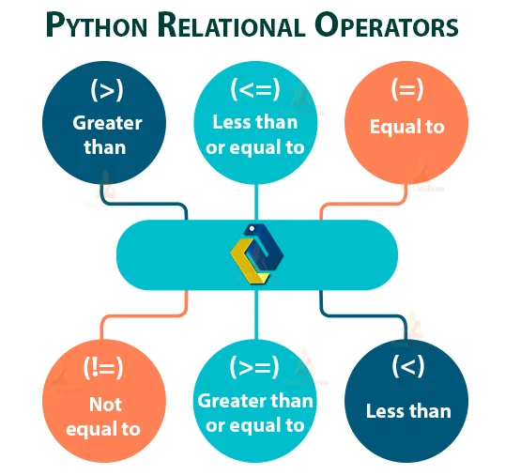
Conditions in Python
A condition is an expression that evaluates to True or False.
Common Comparison Operators:
Example:
x = 10
if x > 5:
print(“x is greater than 5”)
In this example, x > 5 is the condition being evaluated.
Operator | Meaning
== | Equal to
!= | Not equal to
> | Greater than
< | Less than
>= | Greater than or equal to
<= | Less than or equal to

Slide 5
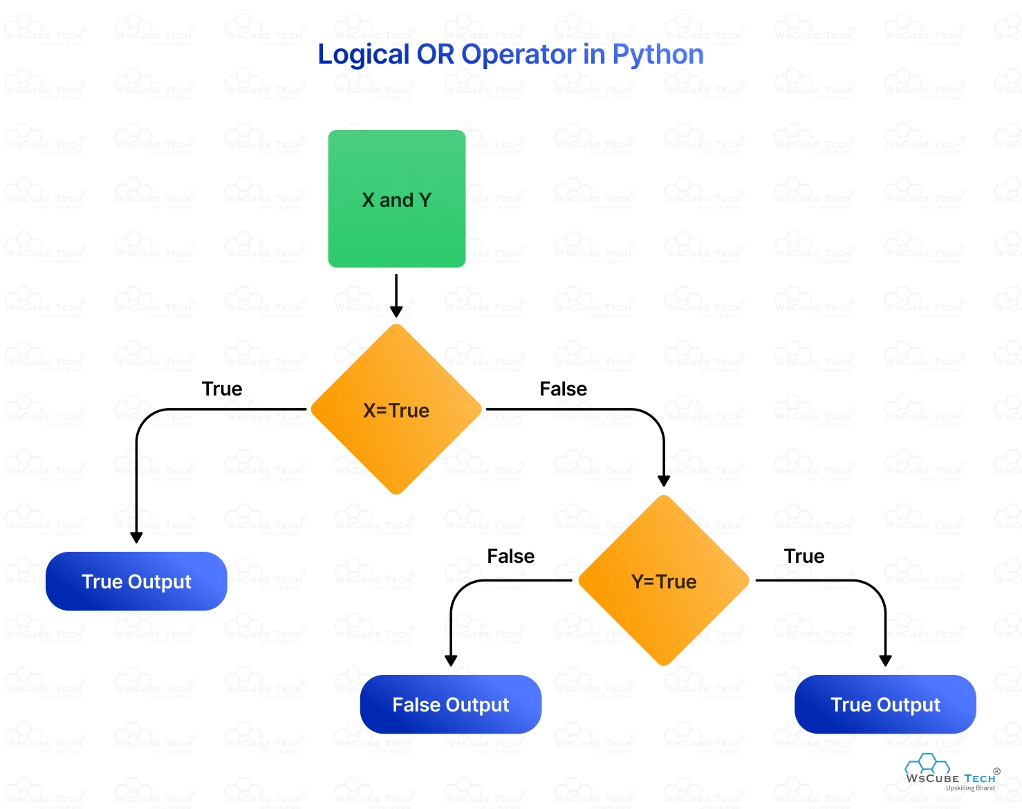
Logical Operators in Python
Logical operators are used to combine multiple conditions and return a True or False result.
Types of Logical Operators:
Examples:
# and operator
age = 20
if age > 18 and age < 30:
print(“You’re a young adult”)
# or operator
grade = ‘B’
if grade == ‘A’ or grade == ‘B’
print(“You passed”)
Operator | Description
and | True if both conditions are True
or | True if at least one condition is True
not | Reverses the result (True ↔ False)

Slide 6
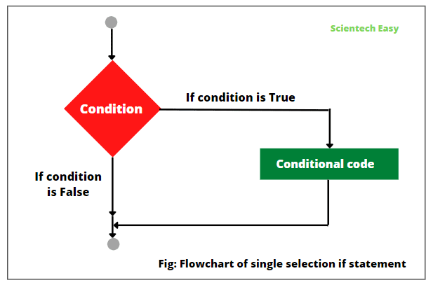
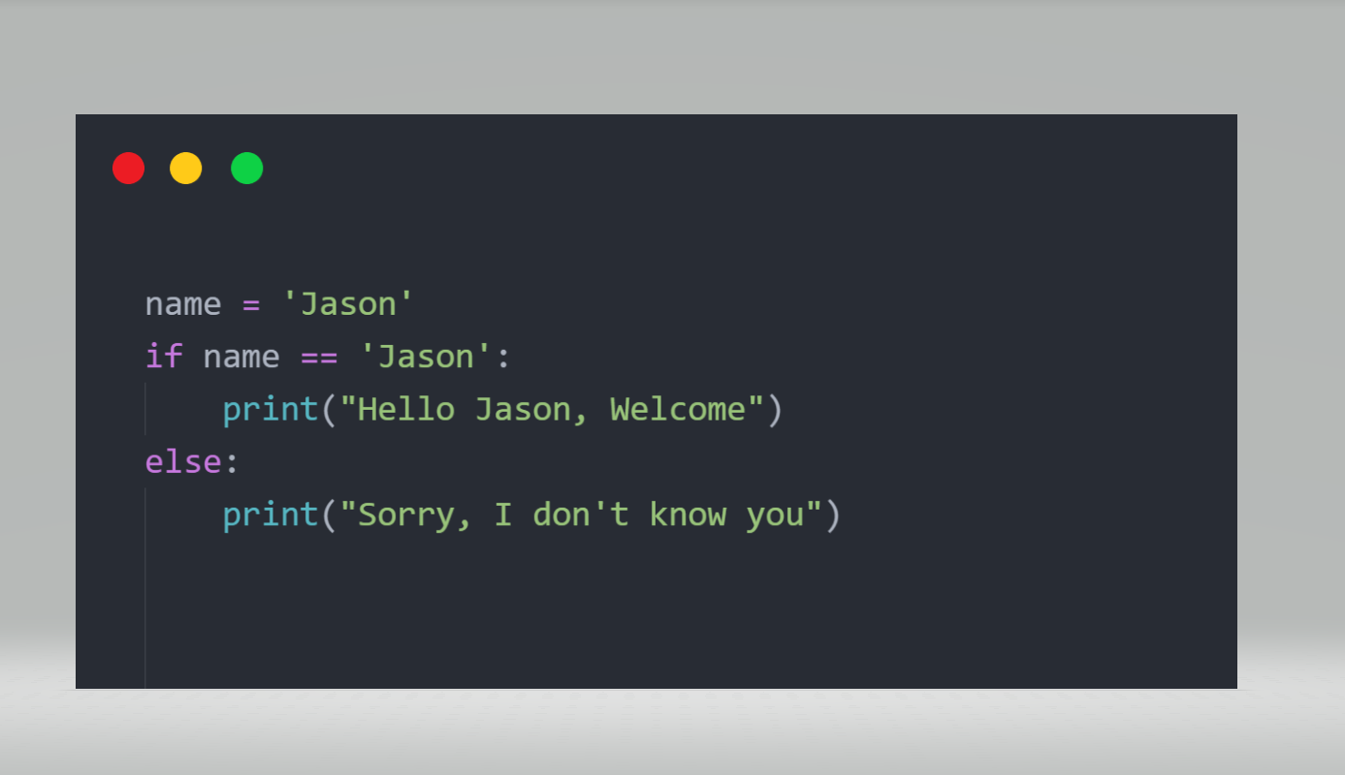
if Statements
Purpose:
if statements allow you to execute code only when a specific condition is True.
Syntax:
if condition:
# code block to execute if condition is True
The condition follows the if keyword and ends with a colon :.
The code block is indented and runs only if the condition is True.
If the condition is False, the block is skipped.
Example:
num = 10
if num > 5:
print(“The number is greater than 5”)
In this example, the message is printed only if num > 5

Slide 7
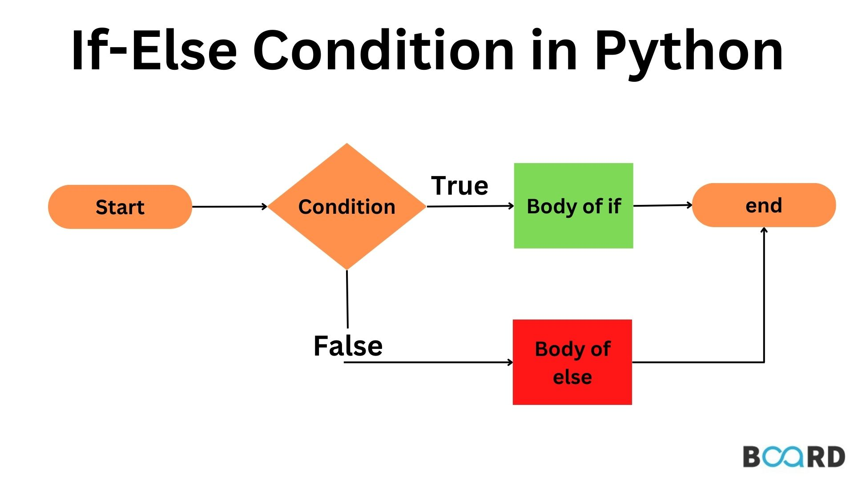
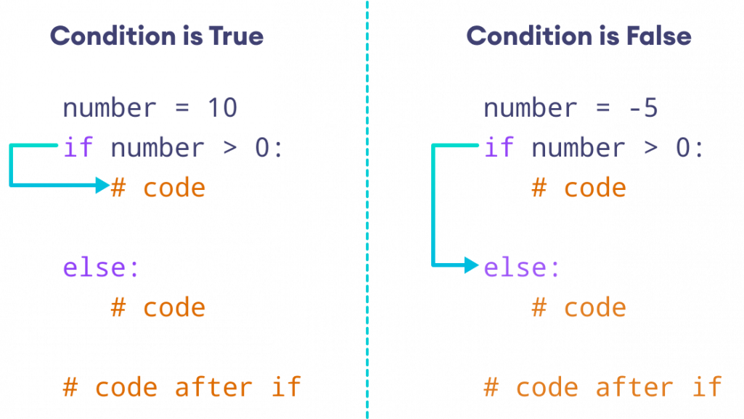
if-else Statements
Purpose:
if-else statements allow a program to take two different actions based on whether a condition is True or False
How it Works:
The if block executes when the condition is True.
The else block executes when the condition is False.
This ensures that one of the two blocks will always run.
Example:
num = 3
if num > 5:
print(“The number is greater than 5”)
else:
print(“The number is not greater than 5”)
Here, since num is not greater than 5, the else block runs and prints the second message

Slide 8
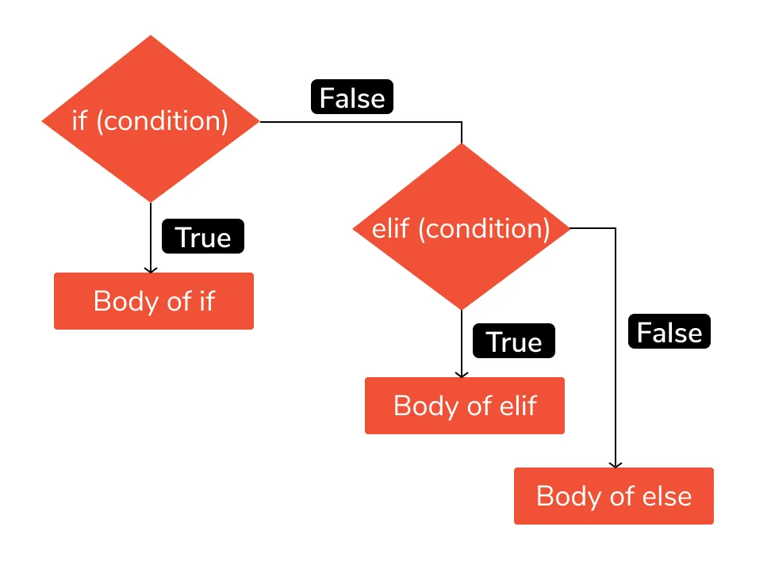
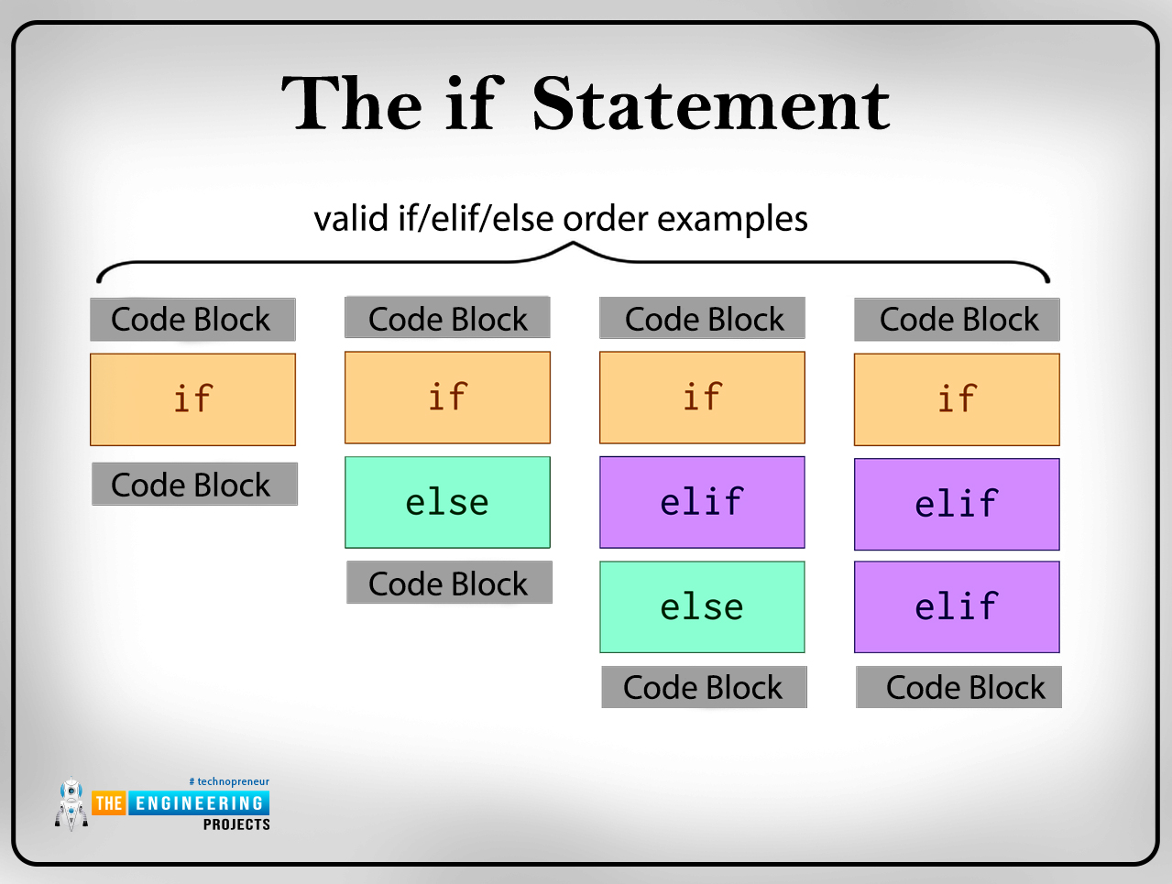
if-elif-else Statements
Purpose:
Used when you need to evaluate multiple conditions and execute different blocks of code based on which condition is True.
How it Works:
The program checks the first condition with if.
If True, it runs that block and skips the rest.
If False, it checks the next condition using elif (else if).
You can have multiple elif blocks.
If none of the conditions are True, the else block is runs as a fallback.
Example
score = 75
if score >= 90:
print(“Grade: A”)
elif score >= 80:
print(“Grade: B”)
elif score >= 70:
print(“Grade: C”)
else:
print(“Grade: D”)

Slide 9
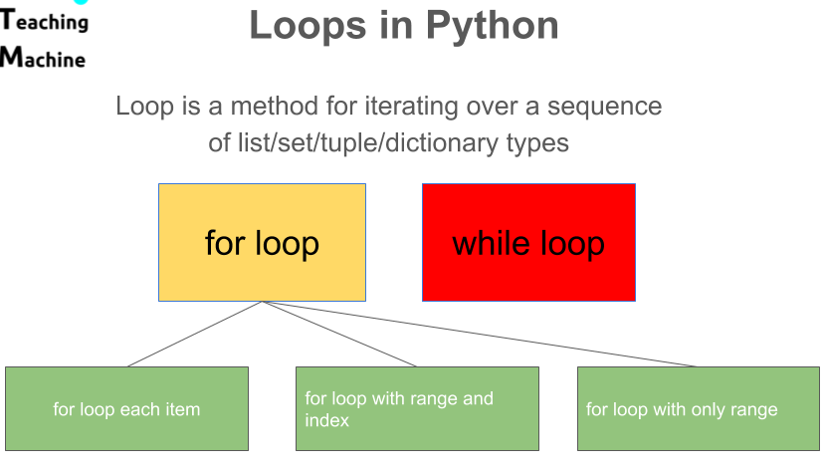
Introduction to Loops
Definition:
Loops are control structures used to repeat a block of code until a specific condition is met.
Purpose:
Automate repetitive tasks and reduce redundancy.
Types of Loops:
while Loop: Repeats as long as a condition is true.
for Loop: Iterates over items of a sequence like lists, tuples, or strings.
Notes:
No do-while loop in python.
- make the code more efficient and readable.

Slide 10
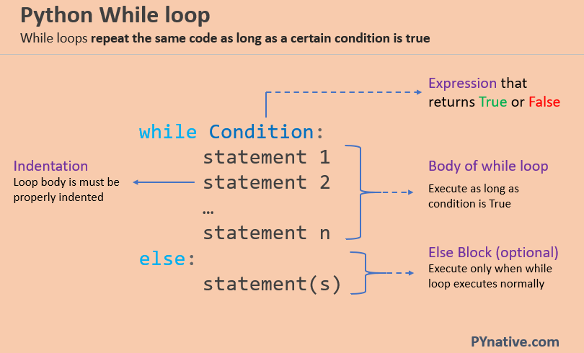
while Loop
How it Works:
The while loop runs as long as the condition is true. If the condition becomes false, the loop stops.
Use Case:
Ideal when the number of iterations is not known in advance.
Example:
count = 0
while count < 3:
print(“Counting:”, count)
count += 1
The loop checks if count is less than 3. If true, it prints the value and increases count by 1.
Prints Counting: 0, Counting: 1, Counting: 2. Stops when count == 3.

Slide 11
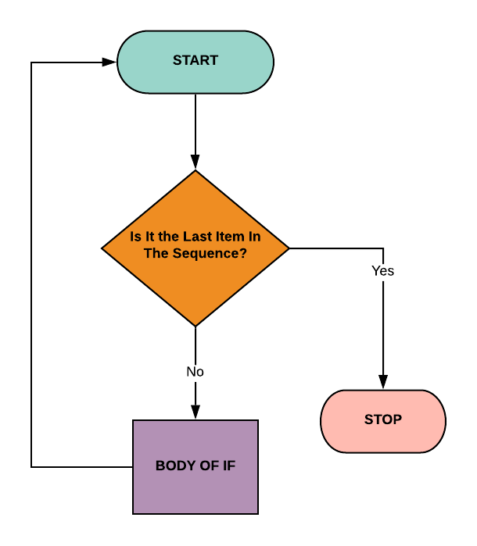
for Loop
How it Works:
The for loop iterates items in a sequence (list, tuple, string, etc.).
Use Case:
Best when the number of iterations is know or fixed.
Example 1 – List:
colors = [“red”, “green”, “blue”]
for color in colors:
print(“Color:”, color)
Example 2 – Dictionary:
data = {“name”: “John”, “age”: 25}
for key, value in data.items():
print(f“{key}: {value}”)

Slide 12
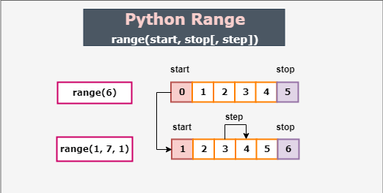
range() Function
Generates a sequence of numbers, commonly used with for loops.
Syntax:
range(start, stop, step)
Parameters of range():
start: Starting number (default is 0).
stop: End number (non-inclusive).
step: Increment (default is 1).
Examples:
Standard Loop:
for i in range(1, 6):
print(i) # Prints 1 to 5
Reverse Loop:
for i in range(5, 0, -1):
print(i) # Prints 5 to 1

Slide 13
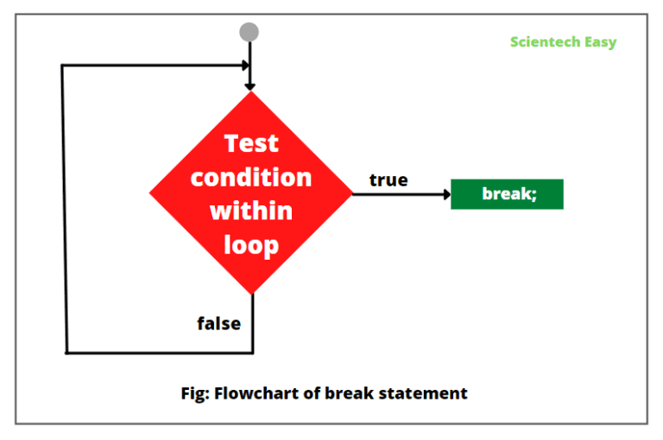
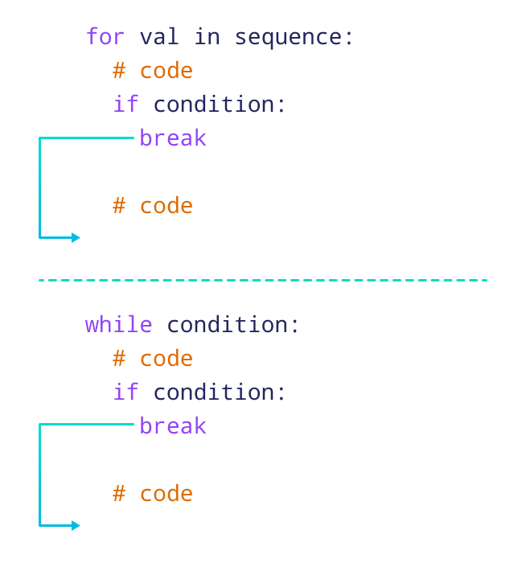
break Statement
Purpose:
Immediately stops the loop when a condition is met.
Example:
for number in range(10):
if number == 5:
break
print(number)
Prints 0 to 4. Stops at 5.
Notes:
Exiting Loops with break

Slide 14
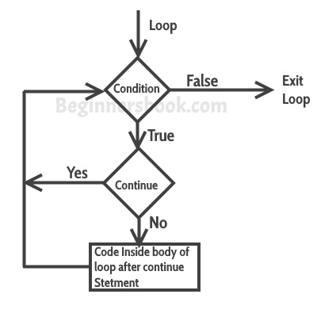
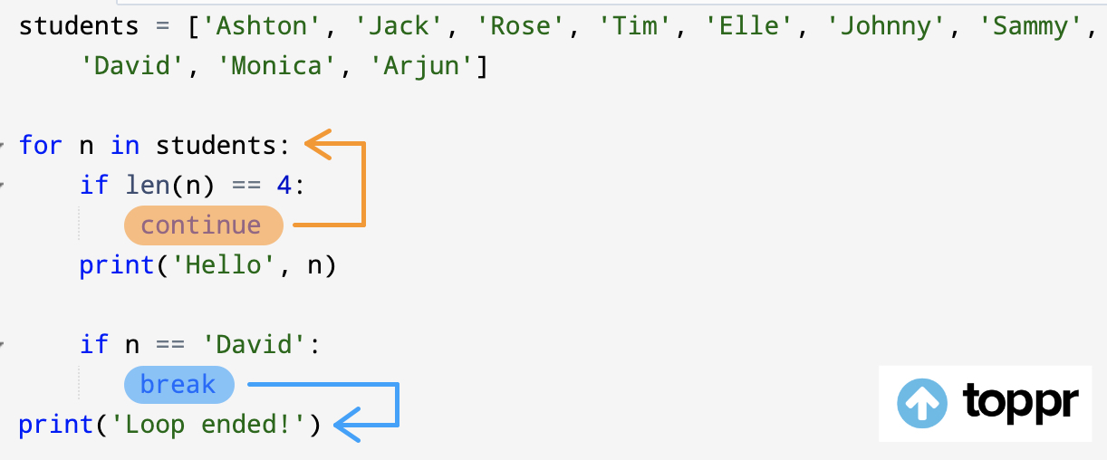
continue statement
Skips the current iteration and moves to the next one.
It doesn’t terminate the loop but simply skips the remaining code for that iteration.
When to Use continue:
To skip unwanted iterations (e.g., skipping certain values in a dataset).
Example:
for i in range(5):
if i == 2:
continue
print(i)
Skips 2. Prints 0, 1, 3, 4.
Notes:
Skipping Iterations with continue

Slide 15
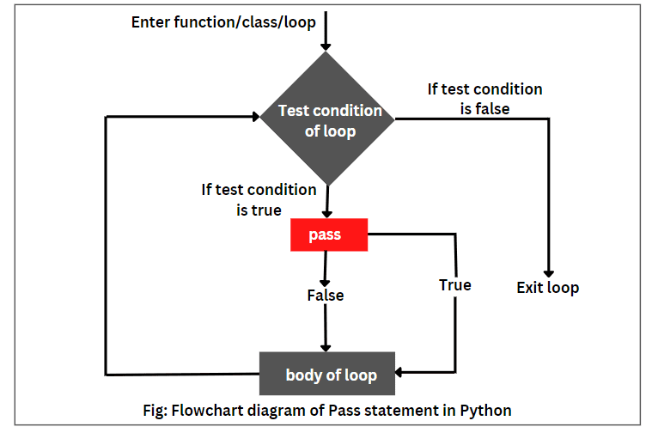
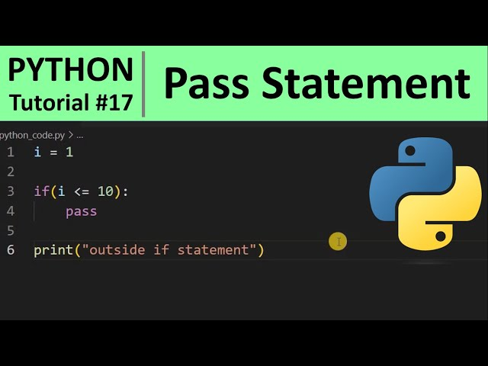
pass statement
Purpose:
Does nothing, used where code is syntactically required but not yet implemented.
The pass statement is a null operation; nothing happens when it is executed. It’s used as a placeholder for code you’ll add later.
Example with pass:
for i in range(5):
if i < 3:
pass
print(i)
pass does nothing; all numbers 0 to 4 are printed.
Notes:
Placeholder with pass
- It’s used as a placeholder for code you’ll add later.

Slide 16

Happy Coding

